Slide 1

























Programming for Engineers
BEP2073
>> Slide 2
>> Control flow: Branching and repetition
Programming procedure on the interaction of data and statement for option, requirement and condition.

Slide 2

Course Learning Outcome
CLO1 | Outline the operational procedure of programming language.
CLO2 | Outline the object-oriented attribute in the programming flow.
CLO3 | Evaluate the program structure on function, branching and condition.
CLO4 | Develop a programming/syntax solution for chemical engineering case study.
CLO5 | Differentiate between solution error and syntax error for complex engineering case study

Slide 3










Revision: Answer on the following
Determine the area of circle with radius of 1.2 m.
Display the reverse order for FirstName and LastName in one sentence.
Calculate 10 user inputs value and give multiplication of all numbers.
Check this sentence and determine total number of vowel.
“UCSI University is a comprehensive university in Kuala Lumpur, Malaysia.”
Given, x = 5. Display Value of x is 5
By using for loop, determine the total possible match of summations between X and Y to give more than 50.
X = [10, 20, 20, 20]
Y = [10, 25, 30, 40]

Slide 4


Operator: Comparison
Operator | Name | Example
== | Equal | x == y
!= | Not equal | x != y
> | Greater than | x > y
< | Less than | x < y
>= | Greater than or equal to | x >= y
<= | Less than or equal to | x <= y

Slide 5

Operator: Logical
Operator | Description | Example
and | Returns True if both statements are true | x < 5 and x < 10
or | Returns True if one of the statements is true | x < 5 or x < 4
not | Reverse the result, returns False if the result is true | not(x < 5 and x < 10)
Operator: Identity
Operator | Description | Example
is | Returns True if both variables are the same object | x is y
is not | Returns True if both variables are not the same object | x is not y

Slide 6

Operator: Assignment
Operator | Example | Same As
= | x = 5 | x = 5
+= | x += 3 | x = x + 3
-= | x -= 3 | x = x - 3
*= | x *= 3 | x = x * 3
/= | x /= 3 | x = x / 3
%= | x %= 3 | x = x % 3
//= | x //= 3 | x = x // 3
Operator | Example | Same As
**= | x **= 3 | x = x ** 3
&= | x &= 3 | x = x & 3
|= | x |= 3 | x = x | 3
^= | x ^= 3 | x = x ^ 3
>>= | x >>= 3 | x = x >> 3
<<= | x <<= 3 | x = x << 3

Slide 7
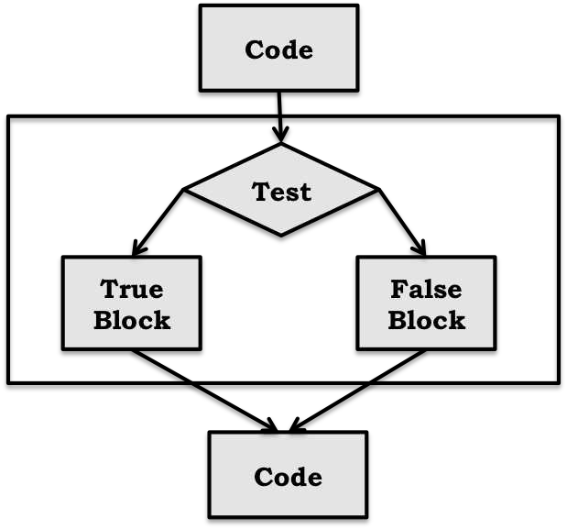

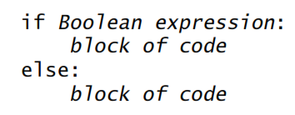



Branching Programs (IF…ELSE…)
Algorithm (Pseudocode)
Flow Chart
Program code
START
Code..
CONDITION if TRUE
Then: True Block
Else: False Block
Code..
END

Slide 8
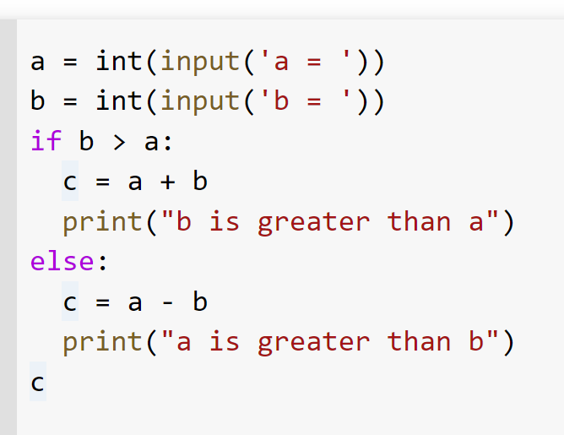

Branching Programs
Indentation is important!
Boolean object. Ie: AND, OR
Rational Operator. Ie: <,>,<=,>=,!=, ==
Equals: a == b
Not Equals: a != b
Less than: a < b
Less than or equal to: a <= b
Greater than: a > b
Greater than or equal to: a >= b
Try-It-Yourself:
a = 33
b = 200
if b > a:
print("b is greater than a")

Slide 9
Example
Python-Code
a = 33
b = 33
if b > a:
print("b is greater than a")
else:
print("a and b are equal")
Python-Code
a = 33
b = 33
if b > a:
print("b is greater than a")
elif a == b:
print("a and b are equal")
START
a = 33
b = 33
b > a
false
a and b are equal
Try-It-Yourself:
a = 200
b = 33
if b > a:
print("b is greater than a")
elif a == b:
print("a and b are equal")
else:
print("a is greater than b")
true
b is greater than a
END

Slide 10
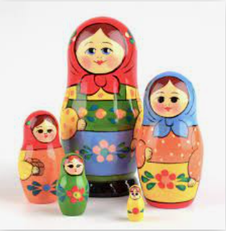


Python-Code
a = 33
b = 33
if b > a:
print("b is greater than a")
elif a == b:
print("a and b are equal")
START
a = 33
b = 33
b > a
false
true
b is greater than a
a == b
false
END
true
a and b are equal

Slide 11
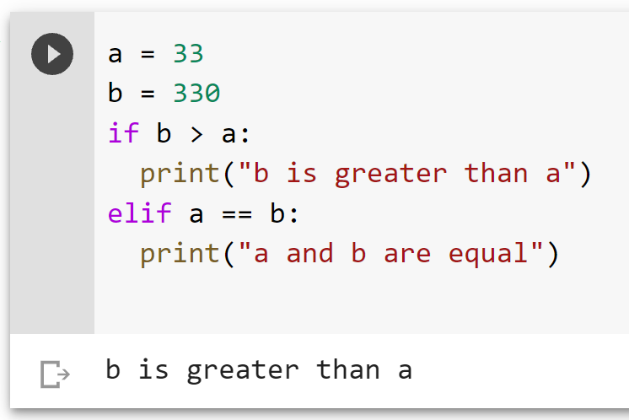
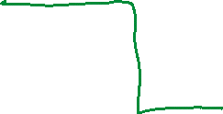
Python-Code
a = 33
b = 33
if b > a:
print("b is greater than a")
elif a == b:
print("a and b are equal")
START
a = 33
b = 33
b > a
false
true
b is greater than a
a == b
false
END
true
a and b are equal

Slide 12
Example
Try-It-Yourself:
a = 200
b = 33
c = 500
if a > b and c > a:
print("Both conditions are True")
Try-It-Yourself:
x = 41
if x > 10:
print("Above ten,")
if x > 20:
print("and also above 20!")
else:
print("but not above 20.")

Slide 13
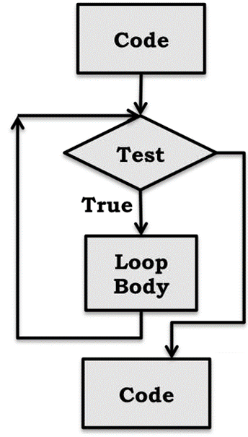
Iteration (FOR & WHILE)
(a.k.a: looping)
Like a conditional statement it begins with a test. If the test evaluates to True.
the program executes the loop body once, and then goes back to reevaluate the test.
This process is repeated until the test evaluates to False.
Try-It-Yourself:
for x in "banana":
print(x)

Slide 14






Example
START
Python-Code
count = 1
for x in range(3):
count = count + 1
print(count)
Count = 1
i < 3
false
true
Try-It-Yourself:
M = ["apple", "banana", "cherry"]
for i in range(len(M)):
print(M[i])
Count = Count + 1
Count
END

Slide 15
Example
START
Python-Code
count = 1
i = 0
while i < 3:
count = count + 1
i = i + 1
print(count)
Count = 1
i = 0
i < 3
false
true
Try-It-Yourself:
M = ["apple", "banana", "cherry"]
i = 0
while i < len(M):
print(M[i])
i = i + 1
Count += 1
i += 1
Count
END

Slide 16
Example
Try-It-Yourself:
#Write a python program to print the square of all numbers from 0 to 10
for i in range(11):
ans = i**2
print(ans)
Try-It-Yourself:
#What is the output of the following for loop and range() function
for num in range(-2,-5,-1):
print(num, end=", ")

Slide 17
Answer on the following
Write a python program to find the sum of all even numbers from 0 to 10
Write a python program to read three numbers (a,b,c) and check how many numbers between ‘a’ and ‘b’ are divisible by ‘c’
Write a python program to check given number is prime or not
Write a python program to print all prime numbers between 0 to 100 and print how many prime numbers are there.

Slide 18
End
https://forms.office.com/r/2R9R8SJibX

